Slide 1
LSC 563 Project Presentation
Dominic Colter

Slide 2
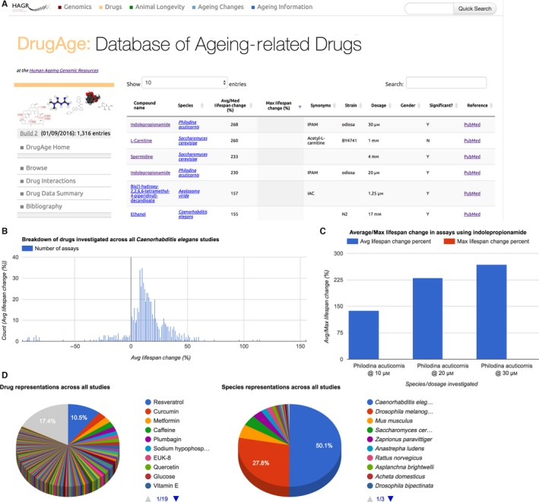
Anti-Aging Compounds
The Human Ageing Genomic Resources (HAGR)
Tools and databases for analyzing the genetics of human aging.
DrugAge database
Collected 324 research publications.
Variables
Compound name
Species (strain)
Average lifespan change (%)
Max lifespan change (%)
Gender
Significance (Removed NS data)
Cas_number
Dosage
PudMed ID
(1)

Slide 3
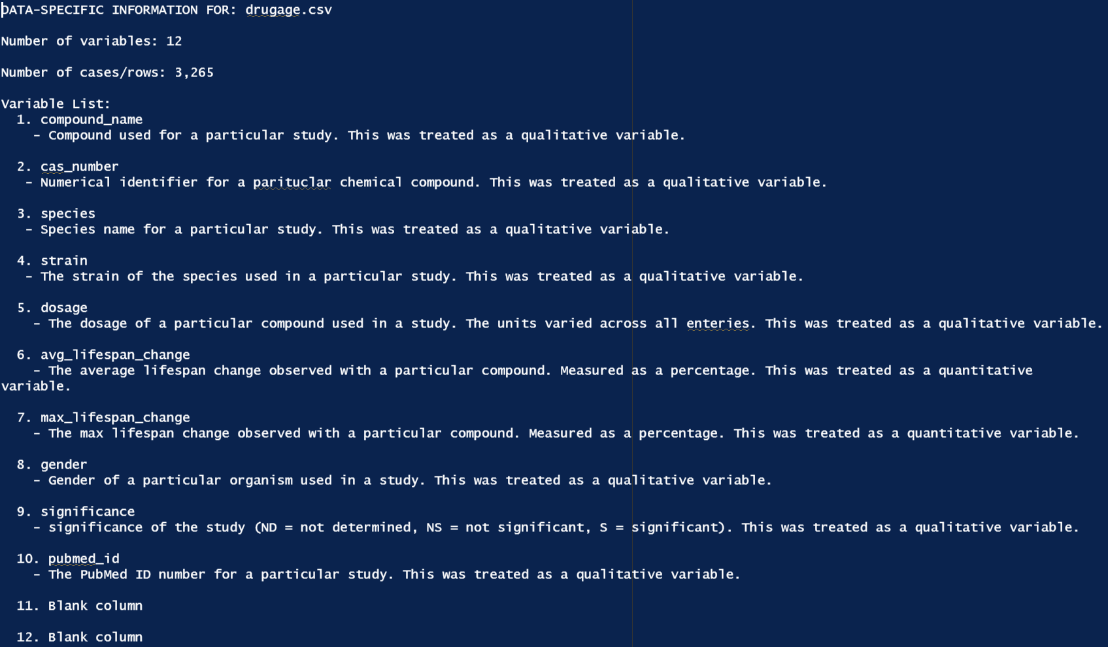
Data Definitions
A molecule or substance must extend lifespan (average, median or maximum), reaching statistical significance in at least one lifespan assay in one model organism.

Slide 4
Research Question
While the DrugAge database contains a variety of compounds that have been shown to increase the lifespan in various model organisms, which compounds should be prioritized and studied more to potentially combat human mortality?
What compounds were the most successful and in which organisms?
Is there an optimal dosage for the most effective compounds?

Slide 5
Data Analysis Plan
Prepare the data and identify data errors.
Familiarize myself with the data through descriptive statistics.
Mean, median, mode, and variation.
Determine possible connections between variables
Find appropriate approaches to visualize these connections.
Document problems encountered, determine alternative options.
Interpret visualizations and discover possible trends.

Slide 6
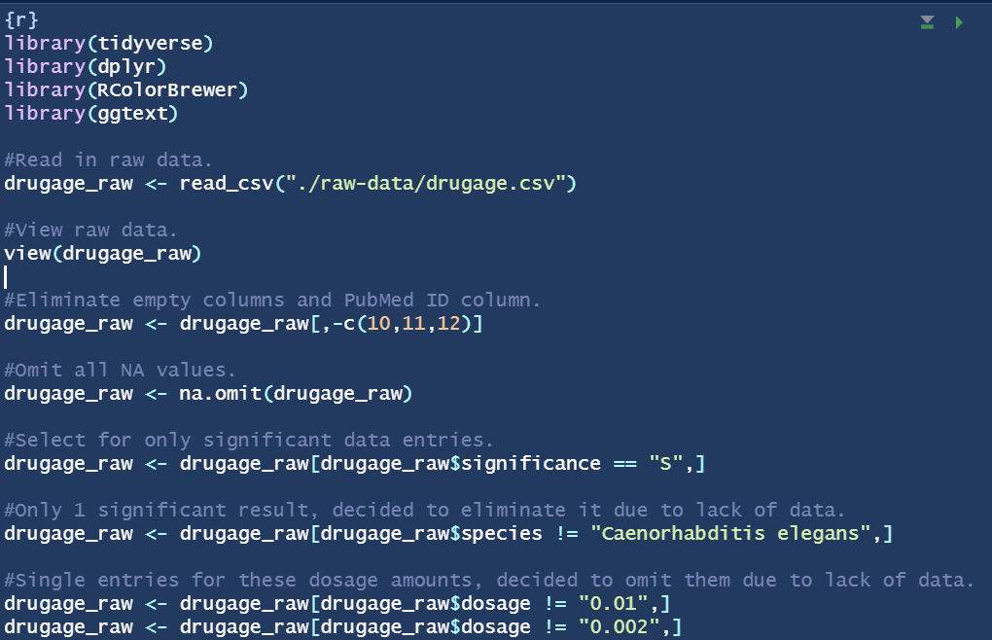
Cleaning Raw Data

Slide 7
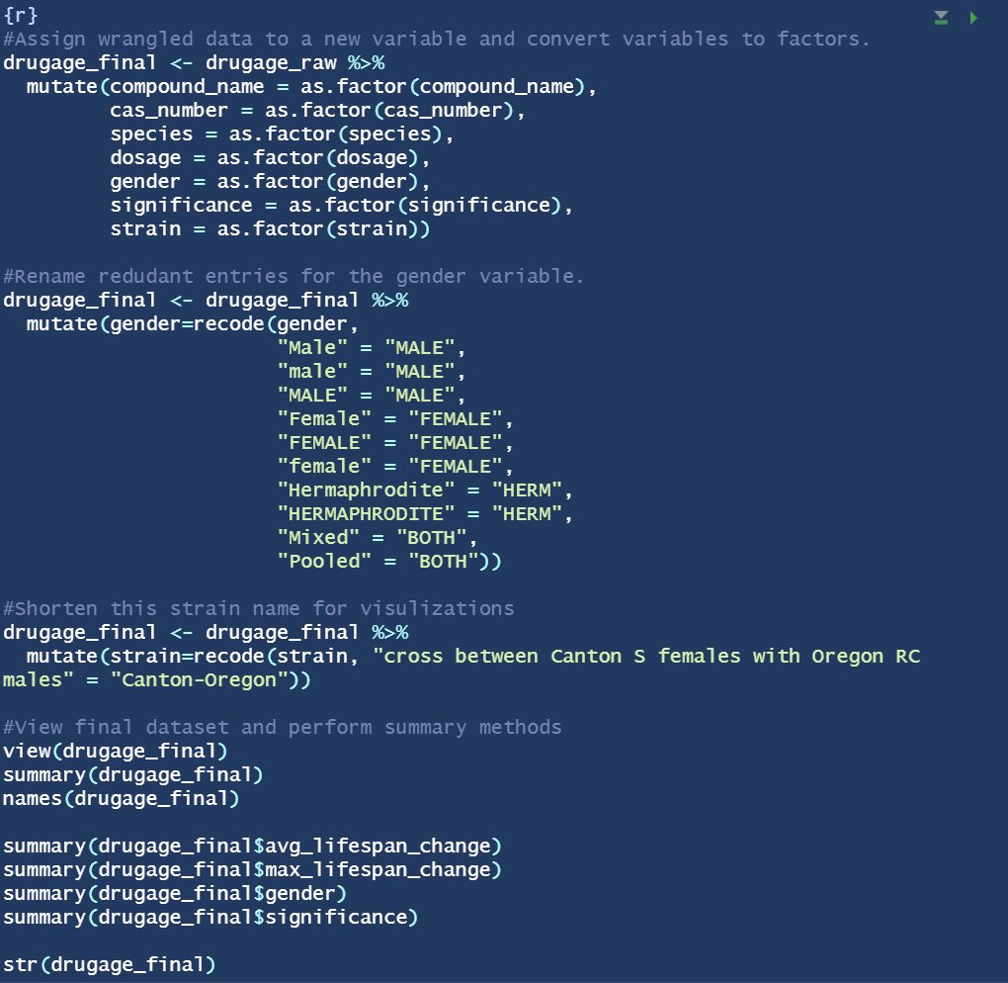
Creating Factors and Fixing Final Data

Slide 8
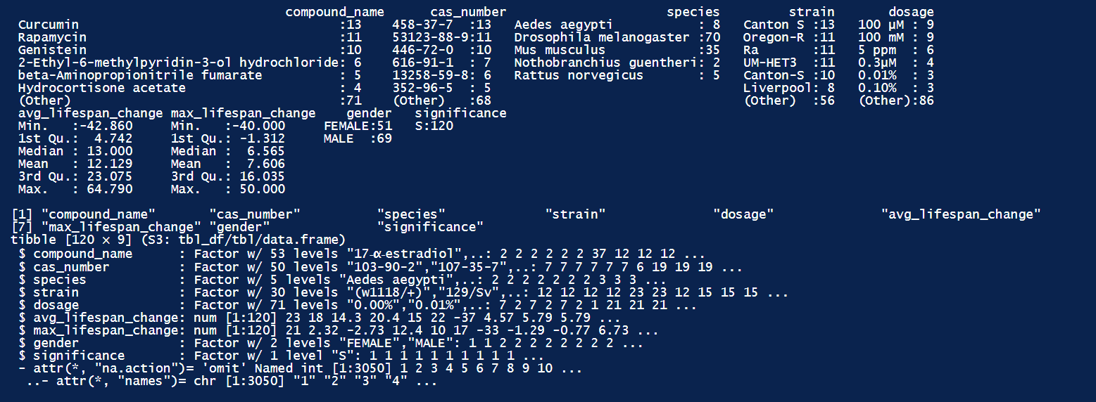
Summary of Final Dataset

Slide 9
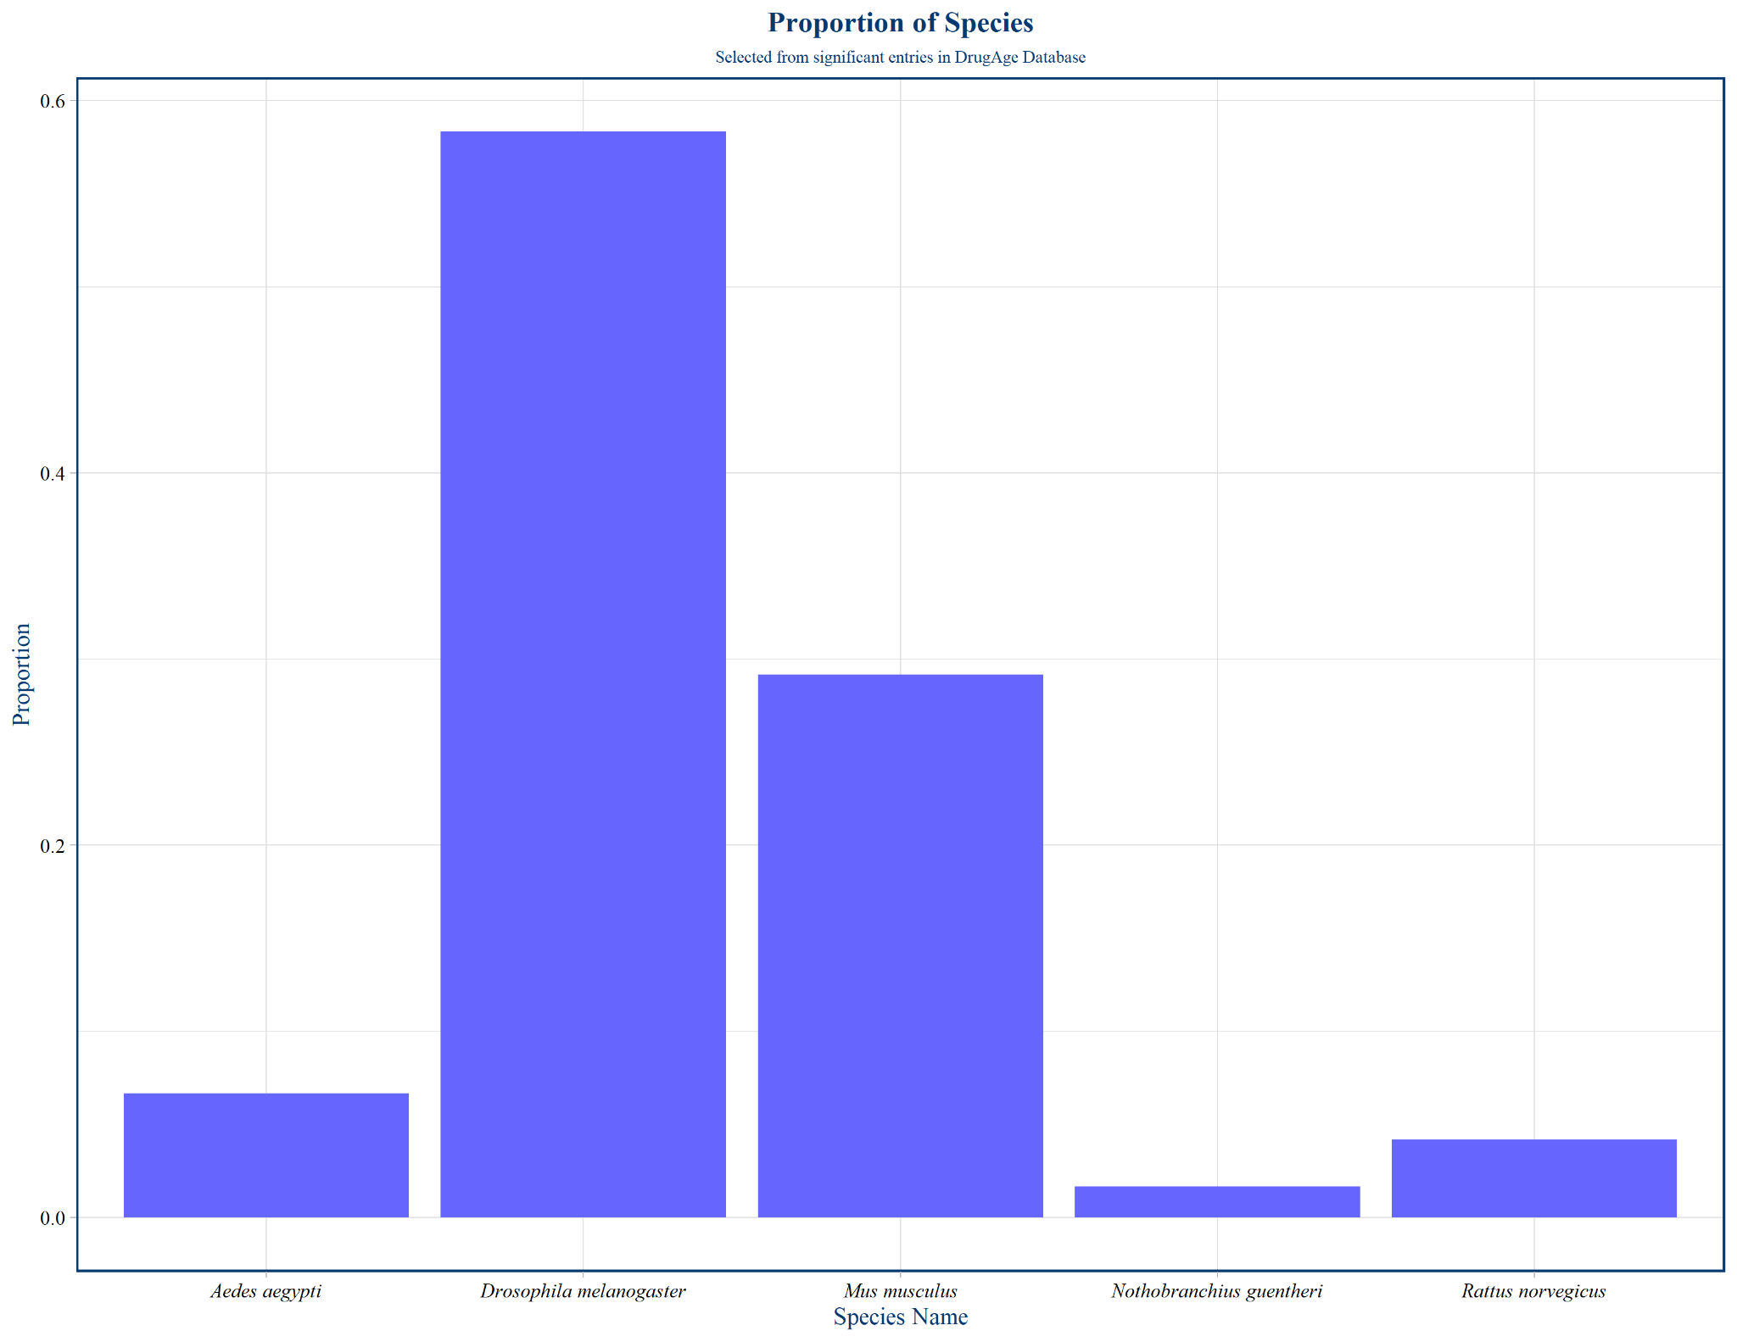

Slide 10
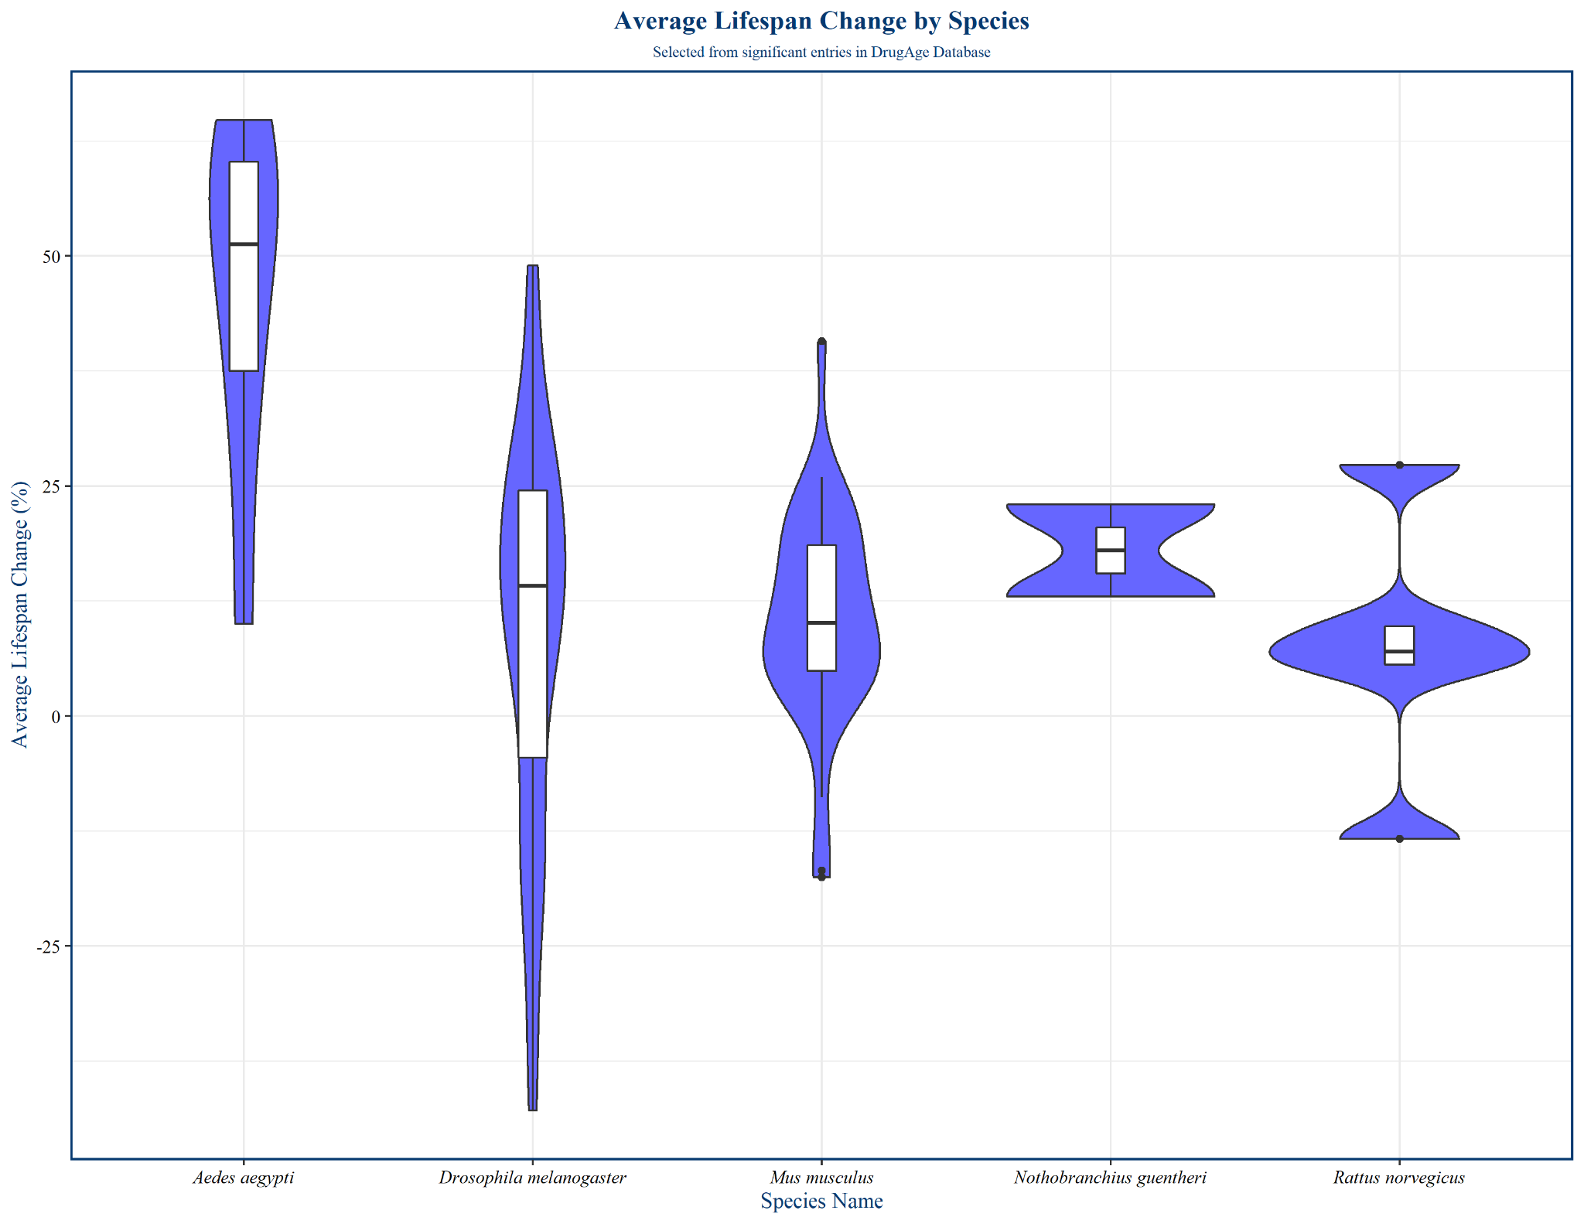

Slide 11
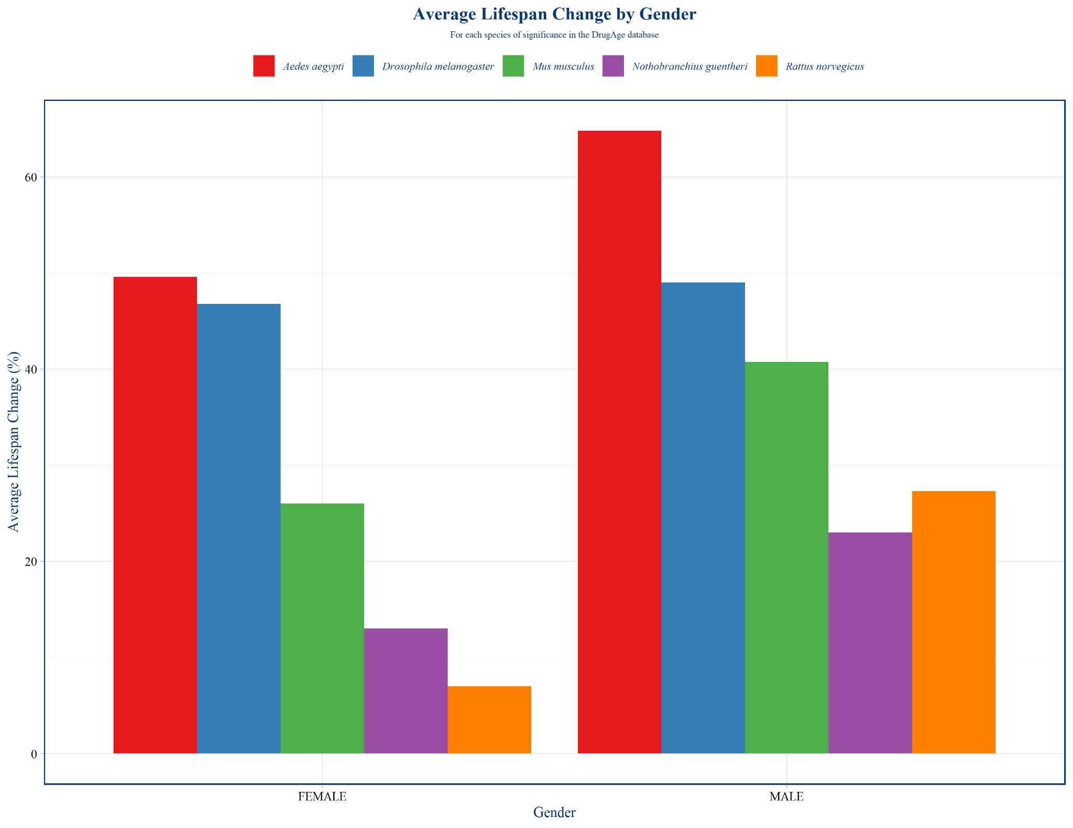

Slide 12
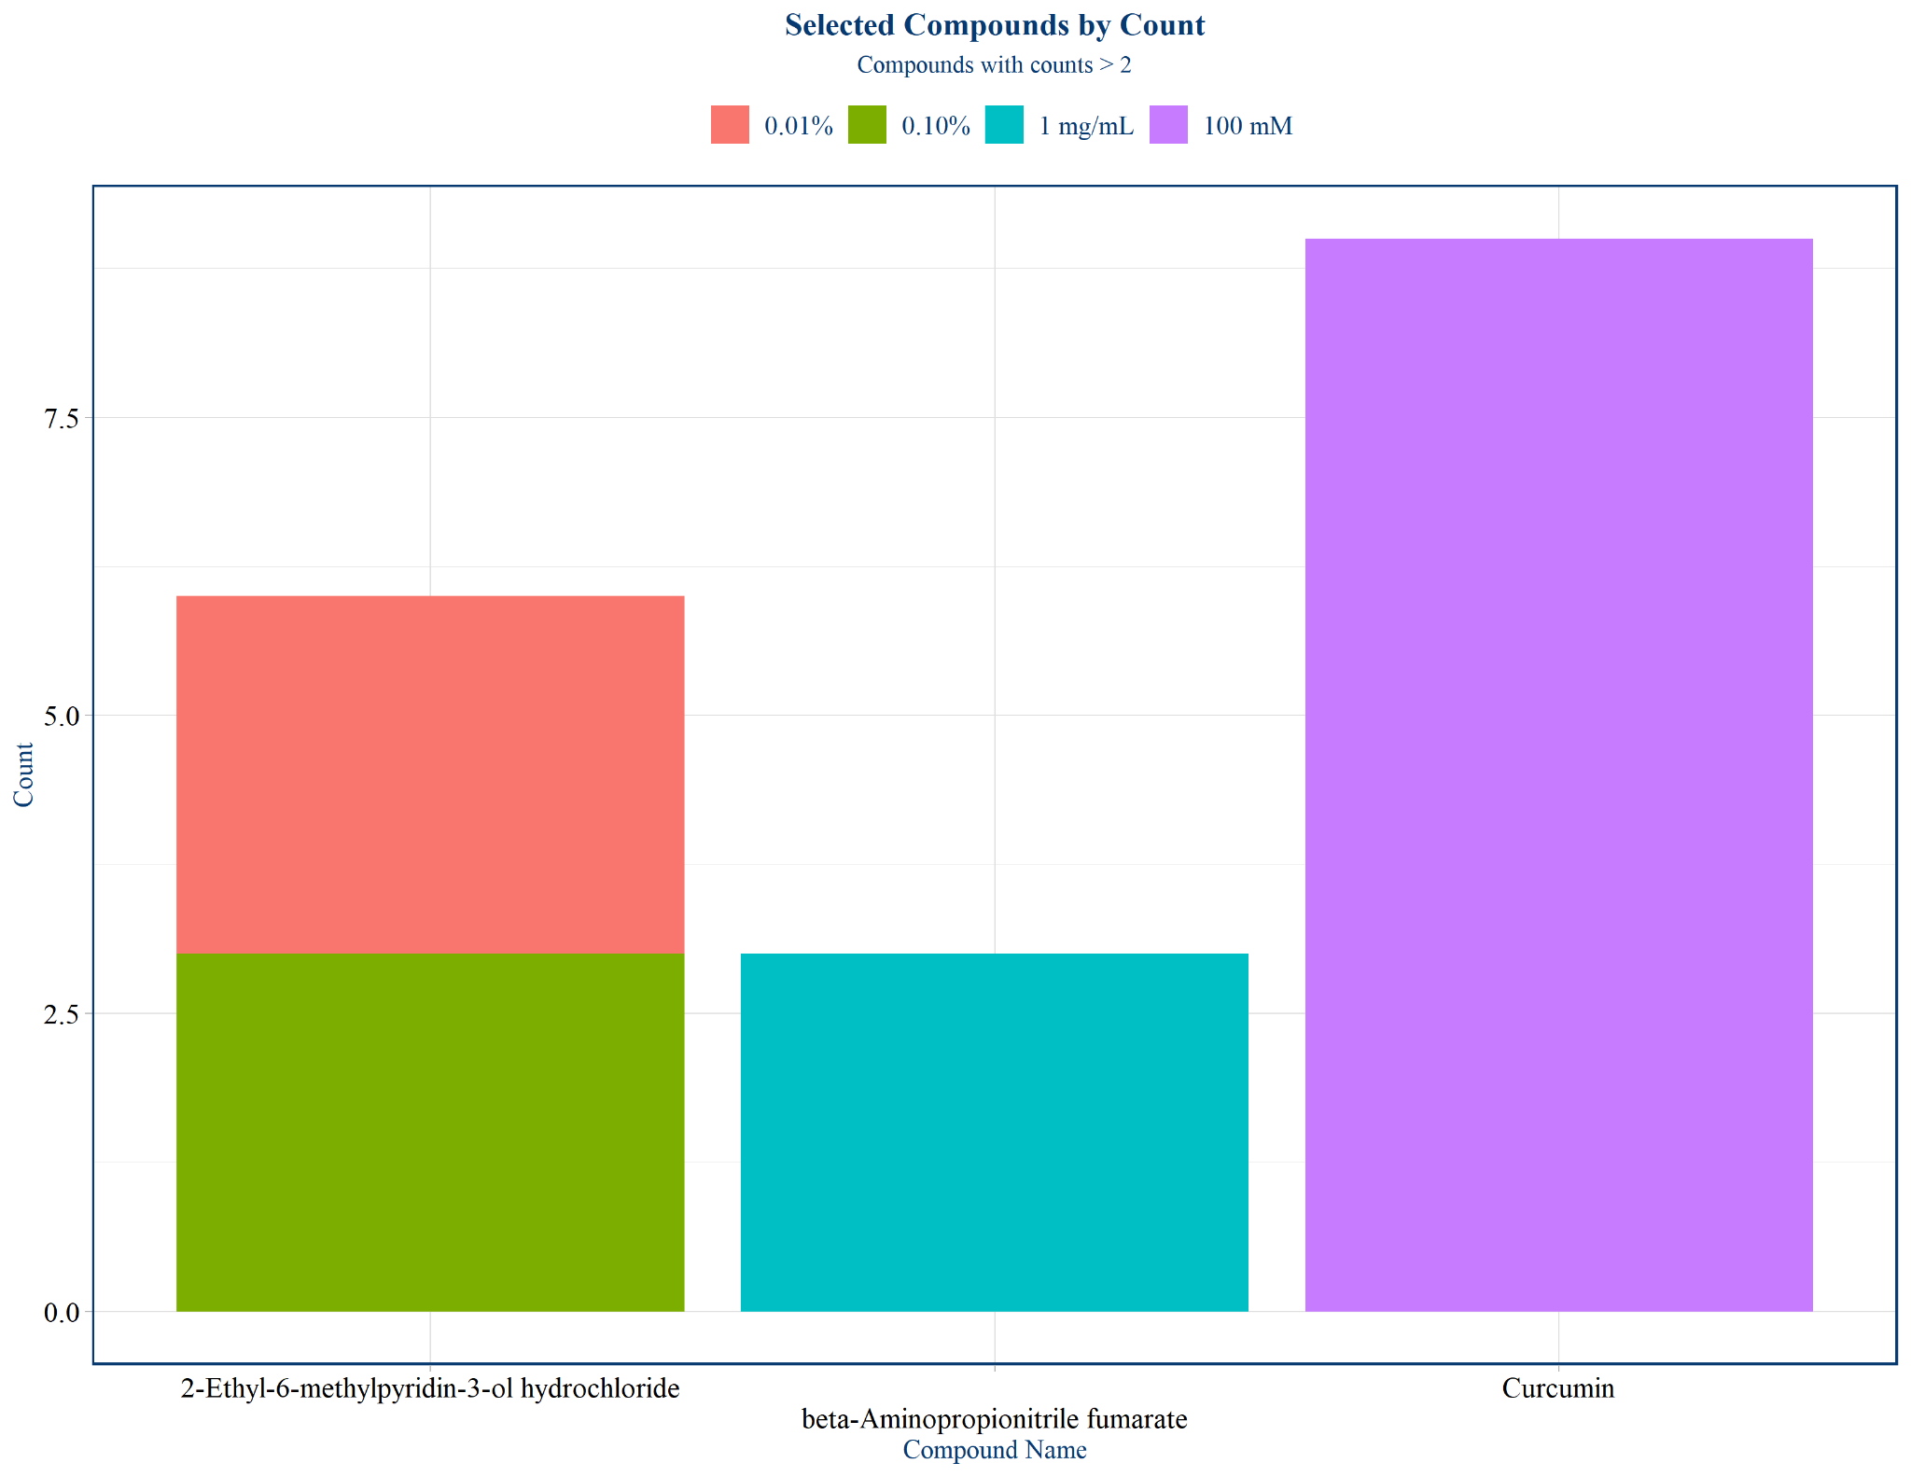

Slide 13
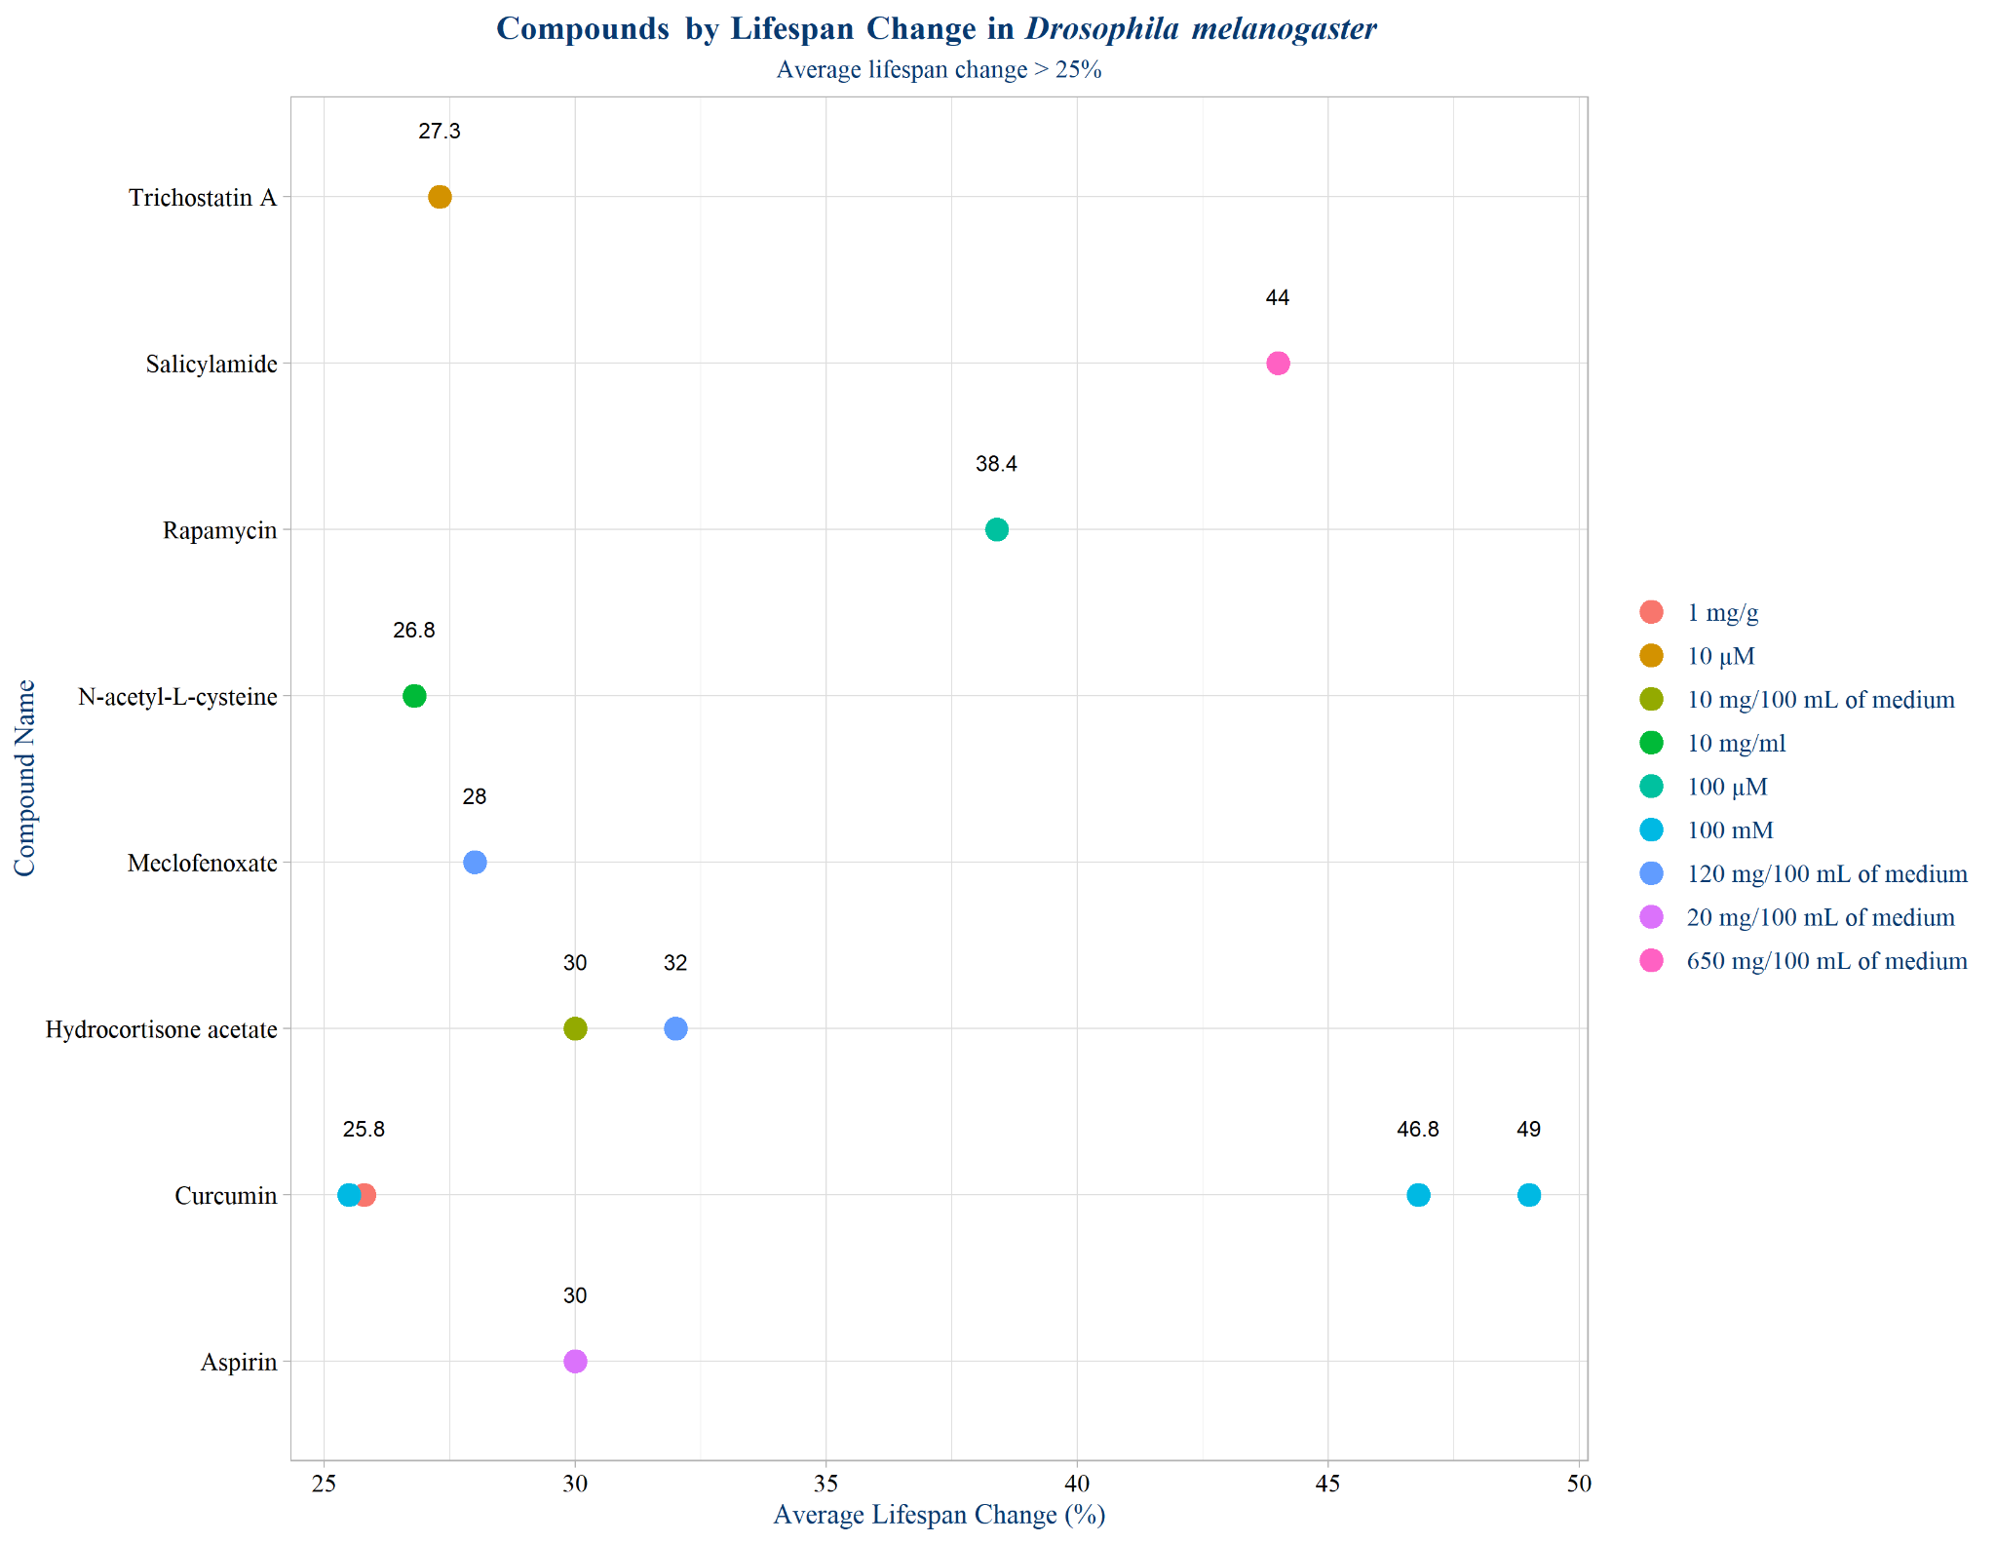

Slide 14
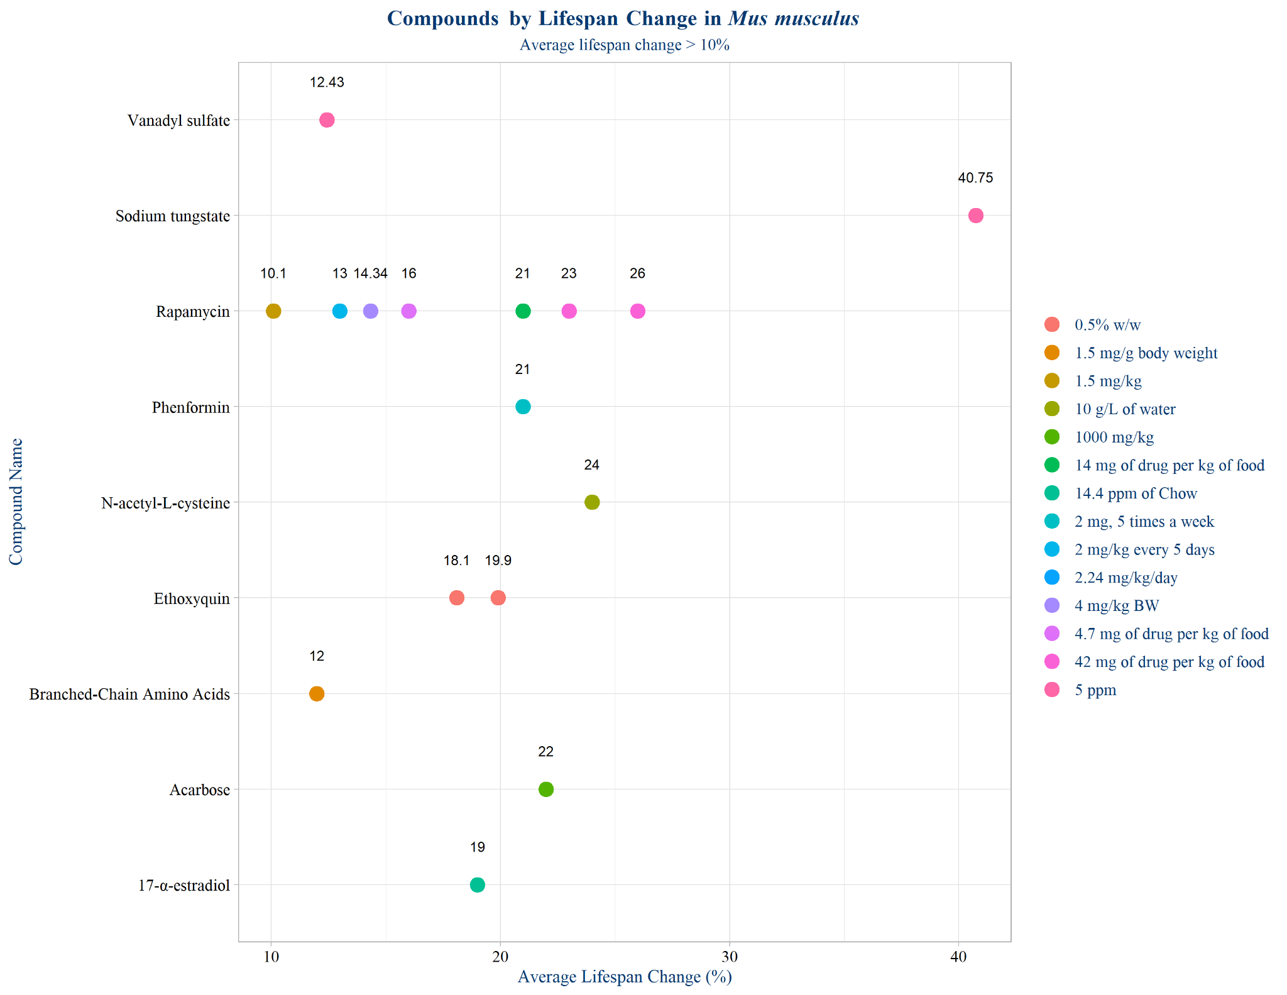

Slide 15
Challenges
Shrinking the dataset to include significant entries.
Shrinking long compound names and dosages to fit on graphs.
Formatting graphs.
Deciding the appropriate scales.
Deciding best visualizations for trends observed since most of the variables were qualitative.

Slide 16
Conclusions
Violin plots, bar charts, boxplots, and scatter plots seemed to work best for this database.
Raw dataset seemed to contain mostly non-significant data entries and a few empty columns.
Wanted to only focus on significant data as determined by the original database.
Analyze another database similar to the DrugAge database to compare and contrast with findings from this project.

Slide 17
References
https://www.ncbi.nlm.nih.gov/pmc/articles/PMC5418190/

